Slide 1
Geotechnical Investigation and field tests

Slide 2
Generally Why stress geotechnical Investigations
Soil/Rock strata very heterogeneous by virtue of it not being a manufactured product
One structure is different from another in terms of founding requirements even if constructed in the same area
Local variations can be of high order
Effect of Water
Perception can be very deceptive – objectivity is essential
Changes are generally not possible
Adverse effects can be disastrous and costly

Slide 3
How do we tackle the problem?
Assessment of uncertainties & applying appropriate conservation ( High FOS)
Study of local geology for interpretation of available sub-surface information
Close observation & intense monitoring during construction stages and modify the designs, if necessary, based on the changes encountered

Slide 4
What is site investigation
Accessibility
Vegetative Cover – clearances and site clearing costs
Availability of water and power
Connection to major transportation routes
Environmental impact
Seismicity
Geological information
Topography and drainage
Subsurface details

Slide 5
What is soil investigation?
Fairly accurate assessment of the characteristics and engineering properties of the soils at a site is essential for
Proper design and successful construction of any structure at the site.
Field and laboratory investigations required to obtain the necessary data for the soils for this purpose - soil exploration

Slide 6
Why Soil Investigation?
Foundation and its depth
Bearing capacity
Settlement analysis
Such other important aspects
depend very much upon the various engineering properties of the foundation soils involved
Design and construction of new structures
Deciding upon remedial measures if a structure shows signs of distress after construction
Investigation of Failures
Use of soil as a construction material

Slide 7
Few recent cases of failures due to lack of soil investigation
Lumding – Badarpur section, NF Railway – BG conversion project
BG alignment is altogether different from MG
Most of the soil cuttings failed due to steep average slope of 0.5 H : 1 V
Cutting slope redesigned by RDSO with much flatter slope
Flattening of cuttings slopes is very difficult and costly

Slide 8
Few recent cases of failures due to lack of soil investigation
MRTS Chennai – Case of construction over soft marine clay
Most of the portion of track is on elevated structure.
About 1.5 to 2 km is on embankment of height 4 to 8 m.
Soft strata of 8 to 10 m depth.
Bank failed during construction & sub-banks of 15 m width were constructed on both side.
Settlement of bank continues & likely to continue for long duration.
MRTS is again planning to construct elevated structure in this portion also. This leads to delay of project and huge expenditure.
This could have been avoided by proper soil investigation and ground improvement by expediting drainage for early consolidation before construction of embankment.

Slide 9
Cases of Failure
Does anyone wants to share his experience in brief with the class?

Slide 10
Objectives of Soil Explorations
Determination of the depth and thickness of the various soil strata and their extent in the horizontal direction,
Location of groundwater and fluctuations in GWT,
Obtaining soil and rock samples from the various strata,
Determination of the engineering properties of the soil and rock strata that affect Performance of the structure, and
Suitability of its use as borrow material
Reasons for the geotechnical problems, if any
To avoid troublesome spots unstable hill sides, swampy areas, soft rock areas, peat lands, etc.

Slide 11
What will we achieve?
Site suitability
Efficient, Economic Design
Anticipate immediate/future problems
Confidence in design assumptions

Slide 12
For Railways
Geotechnical investigation is required to decide/ change in alignment, if required to avoid major problems during and after construction.
To achieve economy in construction
Reduction in track maintenance during service
Inadequate geotechnical investigation leads to problems during construction & unstable formation
Therefore, geotechnical investigation has been made obligatory in Engineering Code (para 409E, 424E, 425E & 528E).

Slide 13
Scope of Soil Investigation and Soil Exploration
Geotechnical investigation mainly includes detailed surface & subsurface exploration
Railway track foundation/sub-grade
New line - new alignment
Doubling / conversion
For existing unstable formation
Foundations of structures – bridges, buildings etc.

Slide 14
Relevant provisions from Engineering Code
Chapter IV – Engineering Surveys Reconnaissance – Preliminary and Final Location Surveys
Para E 409: Field Work:
(iii) Geological mapping may be done and soil surveying by photo-interpretation of remotely sensed data.
(iv) The field work should also cover a soil survey by sampling at suitable intervals, in order to obtain a fair idea of the soil classification and characteristics on the proposed route/routes. Testing of disturbed soil samples is usually adequate but Geophysical survey may be done in rocky terrain
Notes:
409. (i) Field Work.-The field work of a preliminary survey should include a compass traverse along one or more routes with such longitudinal and transverse levels as are sufficient to prepare a "Predicted Section" of the route or routes proposed.
(ii) Where suitable aerial photographs are available, for carrying out preliminary survey by photogrammetric techniques, the "predicted section" of the route or routes proposed will be determined by plotting of contoured strip maps on 1 : 10,000 scales from aerial photographs.
Geological mapping may be done and soil surveying by photo-interpretation of remotely sensed data.
(iii) The field work should also cover a soil survey by sampling at suitable intervals, in order to obtain a fair idea of the soil classification and characteristics on the proposed route/routes. Testing of disturbed soil samples is usually adequate but Geophysical survey may be done in rocky terrain.

Slide 15
Relevant provisions from Engineering Code
Para E 425: In the case of passage through hills, the geological characteristics of the country should be investigated by the Engineer, particularly in respect of the probable stability of the line, and if the importance of the work requires it, the Railway Administration should apply for the assistance of an officer of the Geological Survey of India.
As the method of construction of earthwork will be dependent largely on the nature and classifications of the soils a systematic soil sampling at suitable intervals and up to sufficient depths depending upon the nature of terrain should also be done all along the proposed route. Wherever borrow areas are not located along the alignment soil samples should be collected from such places also. These samples shall then be tested for the standard properties, bore logs prepared and the data used for designing the profiles of the embankments and cutting foundations of important structures as well as the method of undertaking the earthwork.
Notes:
425. In the case of passage through hills, the geological characteristics of the country should be investigated by the Engineer, particularly in respect of the probable stability of the line, and if the importance of the work requires it, the Railway Administration should apply for the assistance of an officer of the Geological Survey of India.
As the method of construction of earthwork will be dependent largely on the nature and classifications of the soils a systematic soil sampling at suitable intervals and upto sufficient depths depending upon the nature of terrain should also be done all along the proposed route. Wherever borrow areas are not located along the alignment soil samples should be collected from such places also. These samples shall then be tested for the standard properties, bore logs prepared and the data used for designing the profiles of the embankments and cutting foundations of important structures as well as the method of undertaking the earthwork.

Slide 16
Relevant provisions from Engineering Code
CHAPTER V: Engineering Surveys – Project, Report, Techno-economic survey Report & Feasibility report:
Project Engineering Estimation of Cost & Construction Schedule-
Para E 528 – Formation: Under this head details should be given regarding formation width on banks and in cuttings, side slopes of banks and cuttings, method of construction of earthwork, borrow areas, compaction of soil, use of special blanketing material, provision of sub-bank, with supporting information on soil investigation and results of core drillings wherever necessary, provision for turfing or other protection for banks and cuttings and for repairing them and for topping banks with selected material, sections of tunnels, retaining walls, side drains and catch water drains.

Slide 17
Relevant provisions from Engineering Code
CHAPTER V: Engineering Surveys – Project, Report, Techno-economic survey Report & Feasibility report:
Para E 528 – Formation (contd…): Some times there is a discrepancy between the values of bench marks used by various departments of Government or by Railways in the neighborhood from which the proposed line starts: and any discrepancy and any error in levels which are known to exist along the proposed line should be mentioned. In the case of projects for additional lines and gauge conversions, if any, special arrangements are required for controlling the blasting for widening of existing cuttings, the method contemplated at the investigation stage may be indicated

Slide 18
Relevant provisions Engg. Code
CHAPTER V: Engineering Surveys – Project, Report, Techno-economic survey Report & Feasibility report:
Project Engineering Estimation of Cost & Construction Schedule-
Para E 528 – Extracts – For formation details, following information requires
Width, side slopes, and method of construction adopted for bank/cutting.
Identification of borrow area
Compaction of soil
Provision of sub bank
Use of special blanketing material
Information of soil investigation
Result of core drilling
Provision of turfing and other protection
Repair of banks from selected materials
Section of tunnels, retaining wall
Catch water drains
Notes:
CHAPTER V: Engineering Surveys – Project, Report, Techno-economic survey Report & Feasibility report:
Project Engineering Estimation of Cost & Construction Schedule-
Para E 528 – Formation: Under this head details should be given regarding formation width on banks and in cuttings, side slopes of banks and cuttings, method of construction of earthwork, borrow areas, compaction of soil, use of special blanketing material, provision of sub-bank, with supporting information on soil investigation and results of core drillings wherever necessary, provision for turfing or other protection for banks and cuttings and for repairing them and for topping banks with selected material, sections of tunnels, retaining walls, side drains and catch water drains.
Some times there is a discrepancy between the values of bench marks used by various departments of Government or by Railways in the neighborhood from which the proposed line starts: and any discrepancy and any error in levels which are known to exist along the proposed line should be mentioned. In the case of projects for additional lines and gauge conversions, if any, special arrangements are required for controlling the blasting for widening of existing cuttings, the method contemplated at the investigation stage may be indicated

Slide 19
SOIL EXPLORATION & SURVEY
Objectives of constructing a stable formation can only be achieved if soil exploration, as envisaged in Engineering Code Paras E--409, 425 and 528, is undertaken in right earnest and precautions are taken to design bank & cutting against likely causes which could render it troublesome during service.
Adequate provision for soil surveys & explorations at different stages, as per requirements of the terrain, should be made in the project estimates to cover the cost for this activity. The cost of geo-technical investigation varies from 0.25 % to 1% depending upon size of the project and type of terrain etc.
The lower percentage is for large projects and vice-versa

Slide 20
Soil investigation during survey
It can be divided into three categories
Reconnaissance
Preliminary Investigation and
Final Investigation

Slide 21
Reconnaissance
Main objective – Maximum surface and sub-surface information without drilling exploratory boring/ test pits to avoid obviously weak locations
Reconnaissance provides information for feasibility studies and for planning the next phase of exploration. This involves :
Search of existing information
Details of the proposed construction
Performance of existing structures
Notes:
Main objective – To collect maximum surface and sub-surface information without drilling exploratory boring/ test pits to avoid obviously weak locations
Aavailable data from geological and topological maps and other soil surveys done in past, existing soil profiles in nearby cuts, quarries are scrutinized. Water table is recorded from local observation and inquiry. The involved soils are classified by visual examination and if necessary, few field/ laboratory tests are conducted for this purpose.

Slide 22
Reconnaissance
Survey reports from other departments
Available data from geological and topological maps and other soil surveys done in past, existing soil profiles in nearby cuts, quarries
Water table from local observation, wells in the area and inquiry.
Classification of soil by visual examination and if necessary, few field/ laboratory tests are conducted for this purpose
Area of prospective borrow material and blanketting

Slide 23
Preliminary Investigation
Primary objective – Obtain sufficient subsurface data to permit selection of the type, location and principal dimensions of all major structure and estimation of earthwork and design of formation.
Scope – Determination of depths, thickness and composition of each soil stratum, location of rock and ground water and also to obtain appropriate information regarding strength and compressibility characteristics of various soil strata.
Testing of disturbed soil sample is generally considered adequate

Slide 24
Detailed Investigation
When the preliminary investigation does not provide sufficient information, detailed investigation is done.
Planned on the basis of information obtained from reconnaissance and preliminary investigation.
Exploration may be similar to the one done in the previous phase BUT MAY BE REQUIRED FOR IMPORTANT STRUCTURES.

Slide 25
Detailed Investigation (Contd)
Includes boring and sampling to obtain representative and/or undisturbed samples to determine engineering properties of soil.
In-situ tests supplemented by laboratory investigations
Assistance may be taken from Geologist, in case of rocky strata, known unstable hill slopes, earthquake prone area and geological fault

Slide 26
Preliminary Survey
Primary objective – Obtain sufficient subsurface data to permit selection of the type, location and principal dimensions of all major structure and estimation of earthwork and design of formation.
Scope – Determination of depths, thickness and composition of each soil stratum, location of rock and ground water and also to obtain appropriate information regarding strength and compressibility characteristics of various soil strata.
Testing of disturbed soil sample is considered adequate
Hand auguring for the embankment
Drilling and use of split spoon sampler in soils and core drilling in rocks for bridges and high embankments
Sampling interval – 500 m for embankment
Seismic refraction, SCPT and DCPT

Slide 27
Final Location Survey
Detailed investigations – locations of important structures viz. high bank, deep cuttings, major bridges etc. are to be located and avoided where weak sub-soil, swampy ground, marshy land exist
Undisturbed soil samples with the help of deep auger sampler or thin- tube samplers are collected for conducting detailed tests viz. shear strength tests & consolidation test to design safe and economical structure and predict settlements
Assistance may be taken from Geologist, in case of rocky strata, known unstable hill slopes, earthquake prone area and geological fault
Sampling interval 200 to 300 m in uniform soil area and closer intervals in difficult areas
Sampling at every 1.5 m and change of strata
Field vane shear tests where sampling is difficult
Detailed investigation of Source of soil and blanket material

Slide 28
Unsuitable Soils for Construction
Soils to be normally avoided are :
Organic clays
organic silts
peat, chalks
dispersive soils
poorly graded gravel and sand with uniformity coefficient < 2
Clays and silts of high plasticity (CH & MH) in top 3m of embankment.
For Construction of New Formation over Soft Compressible Sub-soil, methods such as stage construction, pre- loading, installation of vertical sand drains, installation of prefabricated vertical PVC drains may be planned for strengthening of weak sub soil by expediting consolidation

Slide 29
Doubling/conversion work
In addition to sampling in regular intervals , detailed soil investigation should be done at location known to be troublesome in the existing track
Site details as bulging of slopes, heaving of soil in between sleepers, heaving of cess
Presence of shrinkage cracks, mud pumping, drainage and other relevant information should be collected.
History of trouble as SR, length of troublesome section, settlement and other details of formation trouble experienced.
Data of track maintenance for last three years for track maintenance/attention

Slide 30
Doubling/conversion work
Record condition of ballast, ballast penetration profile at regular intervals or at every telegraph/electric post depending upon seriousness of problem.
Collection of soil samples
For formation trouble soil sampling below ballast penetration.
For bank failure soil sampling should be done along the probable slip circle
For slips, samples should be taken from slip portion and from adjacent side where slips not occurred.
Cross section should be taken by levelling equipment.

Slide 31
Geotechnical Involvement
Project phase | Geotechnical study for types of projects
 | Small | Medium | Large
Feasibility/IAS | Desktop study/ Site investigation | Desktop study | Desktop study
Planning |  |  | Definition of needs
Preliminary engineering |  | Site investigation (S.I.) | Preliminary site investigation
Detailed design |  |  | Detailed site investigation
Construction | Inspection | Monitoring/Inspection | Monitoring/Inspection
Maintenance |  | Inspection

Slide 32
Process of Geotechnical investigation
Preliminary work
Site reconnaissance
Site exploration including field and laboratory testing
Investigation of available construction material
Investigation report

Slide 33
Preliminary work
Collecting general information and examining the already existing data about the soil and geological conditions of site
Topographic Maps - SOI
Geological Maps - GSI
Remote Sensing Imagery – NRSA
Reports of other bodies and publications
Climatic conditions
Regional seismicity
Prior sub-surface investigation reports
Prior construction records of Bridges and other structures
Geophysical methods

Slide 34
Site reconnaissance
Establish by actual inspection of the site and the surrounding areas the nature of the soils, rocks and position of ground water its includes
Local topography
Excavations
Ravines
Quarries
Geological Recy
Accessibility
Existing underground/ overhead utilities
Bench Marks

Slide 35
Site reconnaissance
Evidence of land slides
Behaviour of existing or nearby structure
Water levels in stream
Water courses and wells
Flood marks
Nature of vegetation
Drainage patterns

Slide 36
GEOPHYSICAL
TO GET USEFUL INFORMATION ABOUT STRATIFICATIONS.
THERE ARE TWO METHODS AS PER IS:1892
ELECTRICAL RESISTIVITY
SEISMIC REFRACTION

Slide 37
SEISMIC METHOD
This method make use of variation of elastic properties of strata which affects the velocity of shock waves traveling through them. The required shock wave can be generated by hammer blows on the ground or by detonating a small charge of explosives.
Used to know the depth of bed rock strata

Slide 38
ELECTRICAL RESISTIVITY
In this method the resistance to the flow of an electric current through the subsurface materials is measured at intervals on the ground surface.
May be useful for the study of foundation problems and for finding rock strata under deep soil cover.
Also used for presence and depth of water table

Slide 39
Site exploration
The site exploration is to get information about the following:
Sequence and extent of each soil and rock stratum in the region likely to be affected by the proposed work
Nature of each stratum and engineering properties of soil and rock which may affect the design and mode of construction of proposed structure and its foundation
Location of ground water table and its corrosive effect on foundation material

Slide 40
Investigation – Construction material
Reconnaissance of the borrow area
Soil exploration
Suitability of materials
Methods and equipments for construction

Slide 41
Report Preparation
Preparation of plan of soil investigation done to correlate the field investigation points on the plan
Arranging of the data collected in sequential order
Preparation of bore logs, tables, soil profile charts, graphs etc.
Field test results
Laboratory test results
Analysis of the test results and comparison of the same
Recommendation for the structure foundations and also for any further investigations
Proper preservation of samples

Slide 42
Methods
of
Geotechnical
Investigation

Slide 43
Methods of Geotechnical Investigation
By doing laboratory tests only on soil samples, or
By doing in-situ tests only, or
By combining the two approaches.
Go

Slide 44
Boring and Test Pits

Slide 45
Test Pits
Test pits are excavations which are large enough to permit the entrance of one or more persons,
They also provide a means to obtain hand cut undisturbed samples,
Methods of Test Pits

Slide 46
Exploratory boring
It is quick and economical
Auger boring - used for boring holes up to a depth of 6m in alluvial soil , but it is difficult to operate below water table in sands
Wash boring -In cohesive and non cohesive soils up to a grater depth, wash boring with chopping and jetting are used.
Rotary drilling -If soil is hard churning bits may be used in this type of drilling
Percussion drilling - For rock and gravely soils. In this type of cutting edges using steel shoes and hardened bits

Slide 47
Posthole
Stump or Helical
Spoon
Fig.1: Soil Hand Augers
Video

Slide 48
Fig.2: Hand Auger Sampling

Slide 49
Exploratory boring
Sampling of soil depend on type of information required. As per classification only, disturbed samples will sufficient and for shear parameters u/d samples required.
Nature of ground | Type of sample | Method of sampling
Soil | Disturbed Undisturbed | Hand, auger, Split spoon, Tube, chunk
Rock | Disturbed Undisturbed | Wash sample from percussion/ Rotary drilling, Core

Slide 50
Methods of soil boring
Solid Stem CFA (Continuous Flight Auger)
Hollow Stem CFA
Rotary Wash Borings
Hand Augur Borings
Exploration Pits

Slide 51
Solid Stem CFA Drilling System
In use on drill rig
Bits
Sizes of solid stem
auger flights
Different assemblies of
bits and auger flights

Slide 52
Hollow Stem CFA Drilling system
Sizes of hollow stem auger flights
Outer and inner assembly

Slide 53
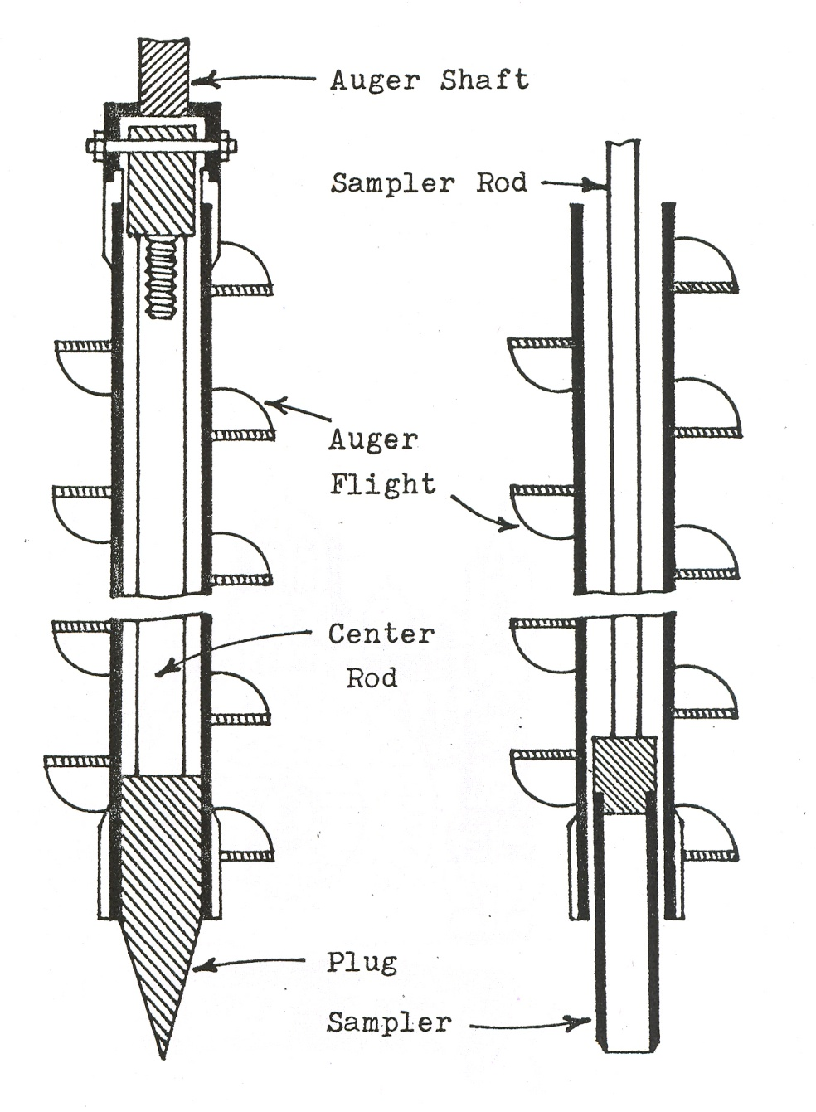
Fig.3: Hollow stem auger

Slide 54
Rotary Wash Boring system
Drill fluid discharge
Drilling Configuration

Slide 55
Stabilization of Borehole
Two common problems associated with the boreholes are – yielding (or caving) of the side and heaving of the bottom of the hole.
Boreholes, particularly below the water table, therefore need stabilization.

Slide 56
Stabilization of Borehole
Two methods :
Lining the walls of the hole with drive pipe or casing
Stabilization by drilling fluid:
Water or bentonite is used.
Under average conditions, 6% bentonite by weight of water is used to make the mud.
Drilling muds are cheaper than casings.

Slide 57
How Many and how deep should be the sampling

Slide 58
Distribution and Depth of Borings
No rigid rules can be set for spacing of borings, so also for depth of borings.
Two major factors are –
The magnitude and distribution of load imposed by the structure, and
The nature of subsurface conditions.

Slide 59
Factors affecting Distribution of Borings
Uniformity or variability of soil strata
Prior Knowledge of the location of the structures
Size of the site
Accessibility of different locations
Criticality of the structure

Slide 60
Guidelines for Boring Layout
Type of Project | Boring Layout
New site of wide extent | Space preliminary borings 60 to 150m apart so that the area between any 4 borings includes approximately 10% of total areas.
Large structure with separate closely spaced footings | Space borings approximately 15m in both directions.
Bridge piers abutments towers, etc. | Minimum 1 or 2 borings for each foundation if the foundation site is determined otherwise 8m apart in erratic & 30m apart in simple profile.

Slide 61
Guidelines for Boring Layout
Type of Project | Boring Layout
Railway line or high way | Generally the borings may be done 200m apart, reducing to 50m apart in erratic soil profile and increasing to 500m or even more for simple profile.
Quarries and borrow areas | Borings may be done as close as 15 to 30m in highly erratic soil profiles, 150 to 300m apart in uniform and 60 to 150m in average subsoil profiles.

Slide 62
Depth of Borings
Depth should be below the zone of seasonal moisture content variation, can be taken as 1.5m for ordinary soils and 3.5m for expansive soils.
In case of floating foundations, where the excavation is carried out so deep that the weight of soil removed equals or exceeds the weight imposed by the structure, depth of exploration need not exceed the base of the foundation.

Slide 63
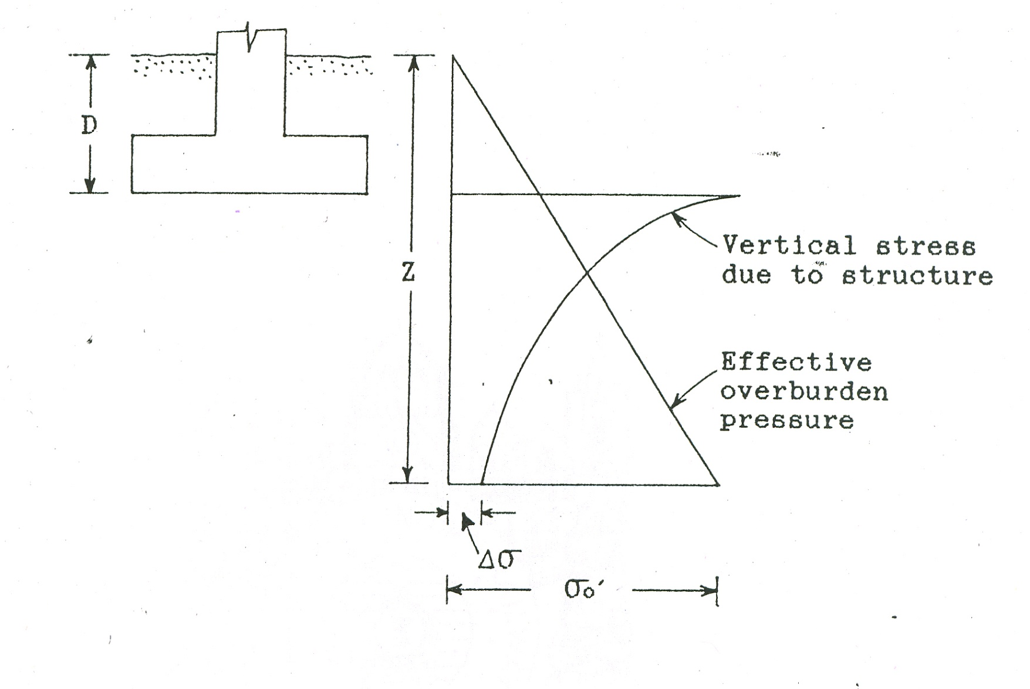
Depth of Borings

Slide 64
Depth of Borings
The following thumb rules can be applied to determine the depth of borings:
Unless bedrock is encountered first
D= Depth of foundation
Z= Depth of investigation
Δσ = Increase in the vertical stress due to the load imposed by the structure at depth Z
σo = Effective overburden pressure
Then, Z should be such
that, Δσ < 10% of σo ; generally
≈ 5% of σo’; when compressible strata.

Slide 65
Depth of Borings
It is advisable to have at least one boring carried to the bed rock or at least to a level well below the level of influence of the loads imposed by the proposed construction.
Where bedrock is encountered, drilling should be done at least 3m into the bedrock to ensure that boulders are not mistaken for sound rock.

Slide 66
Guide line for Depth of Boring
Type of Structure | Depth of Boring
1. Isolated spread footing or raft | 1.5 times the width of footing, B below the lowest part of the foundation
2. Adjacent isolated footings with clear spacing between them less than twice the width | 1.5 times the length of footing, L below the lowest part of the foundation.

Slide 67
Guideline to extent of investigation
Development | Test Spacing | Approximate Depth of Investigation
Building | 20m to 50m | • 1.5B–4.5B for shallow footings (Pads and Strip, respectively) • 3m or 3 pile diameters below the expected founding level for piles. If rock intersected ensure – N∗>100 and RQD>25% • 1.5B (building width) for rafts or closely spaced shallow footings • 1.5B below 2/3D (pile depth) for pile rafts
Bridges | At each pier location and if location not known – 8 m in critical and 30 m in others | • 4B–5B for shallow footings • 10 pile diameters in competent strata, or • Consideration of the following if bedrock intersected – 3m minimum rock coring to make sure it is not isolated boulder – 3 Pile diameters below target founding level based on N∗>150, RQD>50% Moderately weathered or better Medium strength or better

Slide 68
L>=B
B
A
B
G L
D=1.5 B WHEN A>=4 B
D=1.5 L WHEN A<2 B
ISOLATED SPREAD OR MAT FOOTING

Slide 69
B
A
B
A
B
A
B
L= W
B
L
G L
D=4.5 B FOR A<2 B
D=3 B FOR A>2 B
D=1.5 B FOR A>=4 B
ADJACENT ROWS OF FOOTING

Slide 70
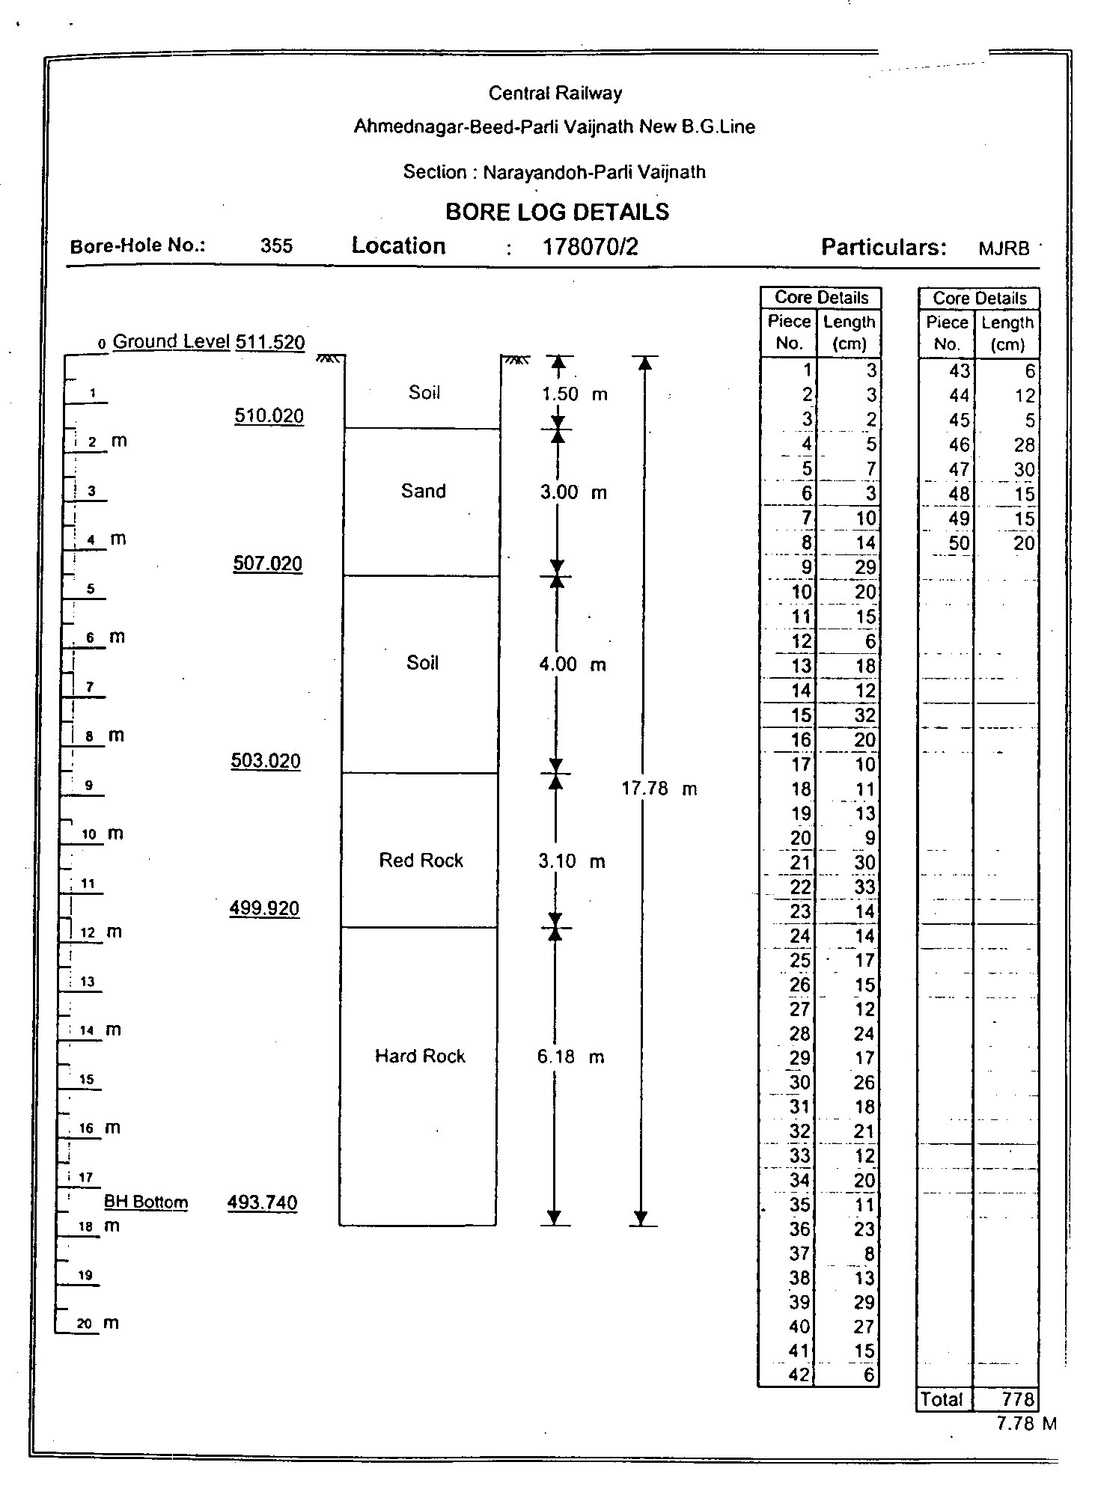

Slide 71
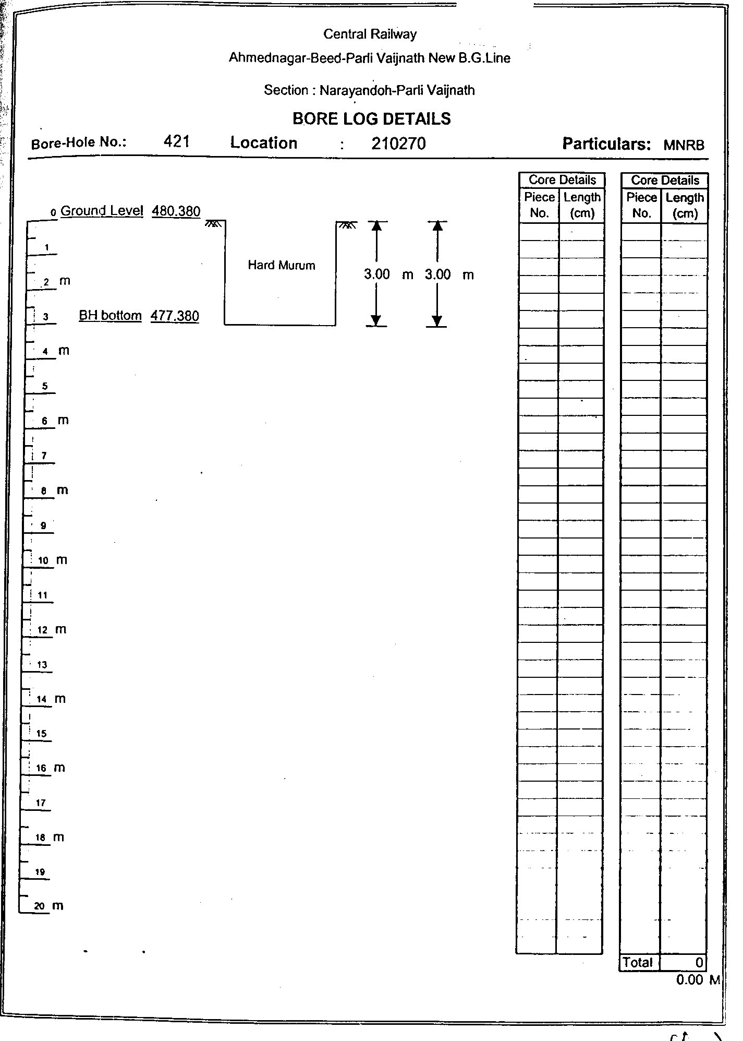

Slide 72
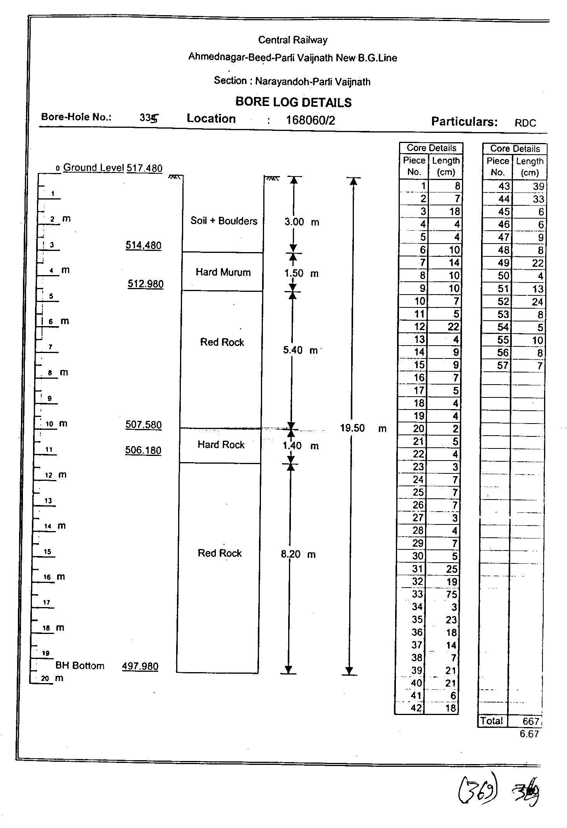

Slide 73
Guide line for Depth of Boring (Contd)
Type of Structure | Depth of Boring
Pile and well foundation | 1.5 times the width of structure from the bearing level, that is from the toe of pile or bottom of well. If the rock is encountered, bore at least 3m into the rock to ensure that it is bed rock and not boulder.

Slide 74
Guide line for Depth of Boring (Contd)
Type of Structure | Depth of Boring
5. Slope Stability | Extend boring below the active or potential failure surface and into hard stratum, or to a depth for which failure is unlikely because of the geometry of cross section of the slope

Slide 75
Guideline to extent of investigation
Development | Test Spacing | Approximate Depth of Investigation
Embankments | 25m to 50m (critical areas) 100m to 500m | Height of bank or 2 m below formation level, whichever is greater. Beyond base of compressible alluvium at critical loaded/suspect areas.
Cut Slopes | 25m to 50m for H >5m 50m to 100m for H <5m | 5m below toe of slope or 3m into bedrock below toe whichever is shallower.
Landslips | 3 BHs or test pits minimum along critical section | Below slide zone. As a guide (as the slide zone may not be known) use 2× height of slope or width of zone of movement. 5m below toe of slope or 3m into bedrock below toe whichever is shallower.

Slide 76
H
B
D=1.5 B or 1.5 H
WHICHEVER IS GREATER
RETAINING WALL

Slide 77
X
G L
D=2m OR X WHICH EVER IS GREATER
FILLIING

Slide 78
H
B
GL
D = 5 m below toe of slope or 3 m into bedrock whichever is less
CUTTINGS

Slide 79
Guideline to extent of investigation
Development | Test Spacing | Approximate Depth of Investigation
Pavements/roads | 250m to 500m | 2m below formation level.
Local roads<150m | 2 to 3 locations
Local roads>150m | 50m to 100m (3 minimum)
Runways | 250m to 500m | 3m below formation level.
Pipelines | 250m to 500m | 1m below invert level.
Tunnel | 25m to 50m | 3m below invert level or 1 tunnel diameter, whichever is deeper: greater depths where contiguous piles for retentions.
Deep tunnels need special consideration |  | Target 0.5–1.5 linear m drilling per route meter of alignment. Lower figure over water or difficult to access urban areas.

Slide 80
Sampling
Type of samples
Disturbed sample
Undisturbed sample

Slide 81
Sampling (Contd)
Disturbed samples are used for :
Identification tests such as visual classification, natural moisture content, grain size analysis, Atterberg limit tests, and for specific gravity test.
Compaction test on borrow material to be used in earth structures, shear and compressibility tests for use in earth structures
Hole logging to detect critical layers.
Disturbed samples should be taken at vertical intervals of not less than 1.5m, and at every change of stratum.

Slide 82
Methods of Disturbed Sampling
Method | Applicability and Limitations
1. Auger | Hand augers are useful to take disturbed samples in all types of soils except in cohesion less soils below the water table and in hard or cemented soils.
2. Percussion drilling | Used for sampling in rock

Slide 83
Methods of Disturbed Sampling
Method | Applicability and Limitations
3. Rotary Drilling | May be satisfactory for identification of sand/rock type.
4. Standard penetration test (SPT) | Applicable in all types of soils except in soils having large size gravels and boulders.

Slide 84
Undisturbed Sampling
The most important step in testing the soil is to obtain a soil sample with as little a disturbance as possible.
The best undisturbed samples are those in which the water content remains unchanged, and the void ratio and structure are changed as little as possible.
Required to get stress history of soil, undrained strength of soil, initial void ratio etc.

Slide 85
Undisturbed Sampling
Undisturbed soil samples may also be used for all those tests for which disturbed samples are used.
Undisturbed samples should be taken at vertical intervals of not more than 1.5m and also at every change of stratum (IS 10108-1982).
Two methods of collecting undisturbed samples .
Chunk samples and tube samples from test pits or trenches
Tube samples by samplers

Slide 86
Undisturbed Sampling
Taking of undisturbed tube samples in cohesive and semi-cohesive soils requires a thin-walled tube sampler with proper clearance at the cutting edge.
A tube is said to be thin walled when the area ratio of the tube does not exceed 10%
Area ratio is the cross-sectional area of the wall of the sampling tube divided by the cross sectional area of the soil sample.

Slide 87
Sampler
Split Barrel / split spoon Samplers

Slide 88
Sampler (Contd)
Open Split barrel sampler with soil sample and cutting shoe

Slide 89
Thin Walled Samplers
(shelby tubes)

Slide 90
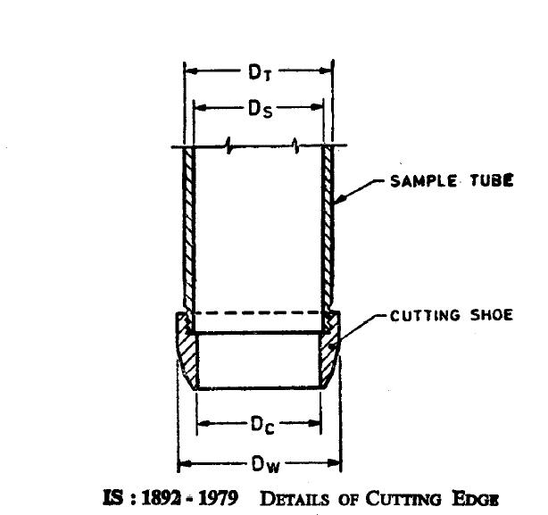
Inside Clearance
Not > 1 to 3%
Ci = (Ds – Dc)/Dc
Allows for elastic expansion of the soil and reduces frictional drag
Outside Clearance
Not > 1 to 3%
Co = (Dw – Dt)/Dt
Facilitates withdrawal of sampler tube
Area Ratio
Not > 20% for stiff formations
Not > 10% for soft sensitive clays
Ar = 100 x (Dw2 – Dc2)/ Dc2
To reduce the disturbace to the sample
Recovery ratio Rt = L/H
Between 98 to 96%
L – Length of sample within the tube
H – Depth of the penetration of the sampling tube

Slide 91
Requirement of Sampling Tubes
Thin-Walled Tubes – IS 2132 - 1986
Inside Diameter (mm) | 38 | 70 | 100
Outside Diameter (mm) | 40 | 74 | 106
Minimum effective length available for soil sample (mm) | 300 | 450 | 450
Area Ratio (%) | 10.9 | 11.8 | 12.4
Note: Sampling tubes of intermediate or larger diameters may also be used.

Slide 92
Percentage use of common sampling methods
Sampler | Disturbed/ Undisturbed | Appropriate Soil Types | % use in Practice
Split-Barrel (Split Spoon) | Disturbed | Sands, Silts, Clays | 84
Thin-Walled Shelby Tube | Undisturbed | Clays, silts, fine grained soils, clayey sands | 6
Continuous Push | Partially Undisturbed | Sands, silts & Clays | 4

Slide 93
Rocks
Core of rocks should be collected by means of rotary drills with a coring bit.
Normally double core barrels are used.
The bit may be diamond, carbide or saw tooth

Slide 94
Split barrel sample jar, tube, storage box for transportation of jar samples

Slide 95
Rock Quality Designation (RQD) -indicator of general quality of rock for engineering purposes.
RQD= Length of core in pieces100mm and above
Length of run
RQD (%) | Description of rock quality
0-25 | Very poor
25-50 | Poor
50-75 | Fair
75-90 | Good
90-100 | Excellent
RQD is an indirect measure of number of fractures and the amount of softening or alteration in a rock mass.

Slide 96
Drill Bits
Diamond
Carbide
Saw tooth

Slide 97
Core Box

Slide 98
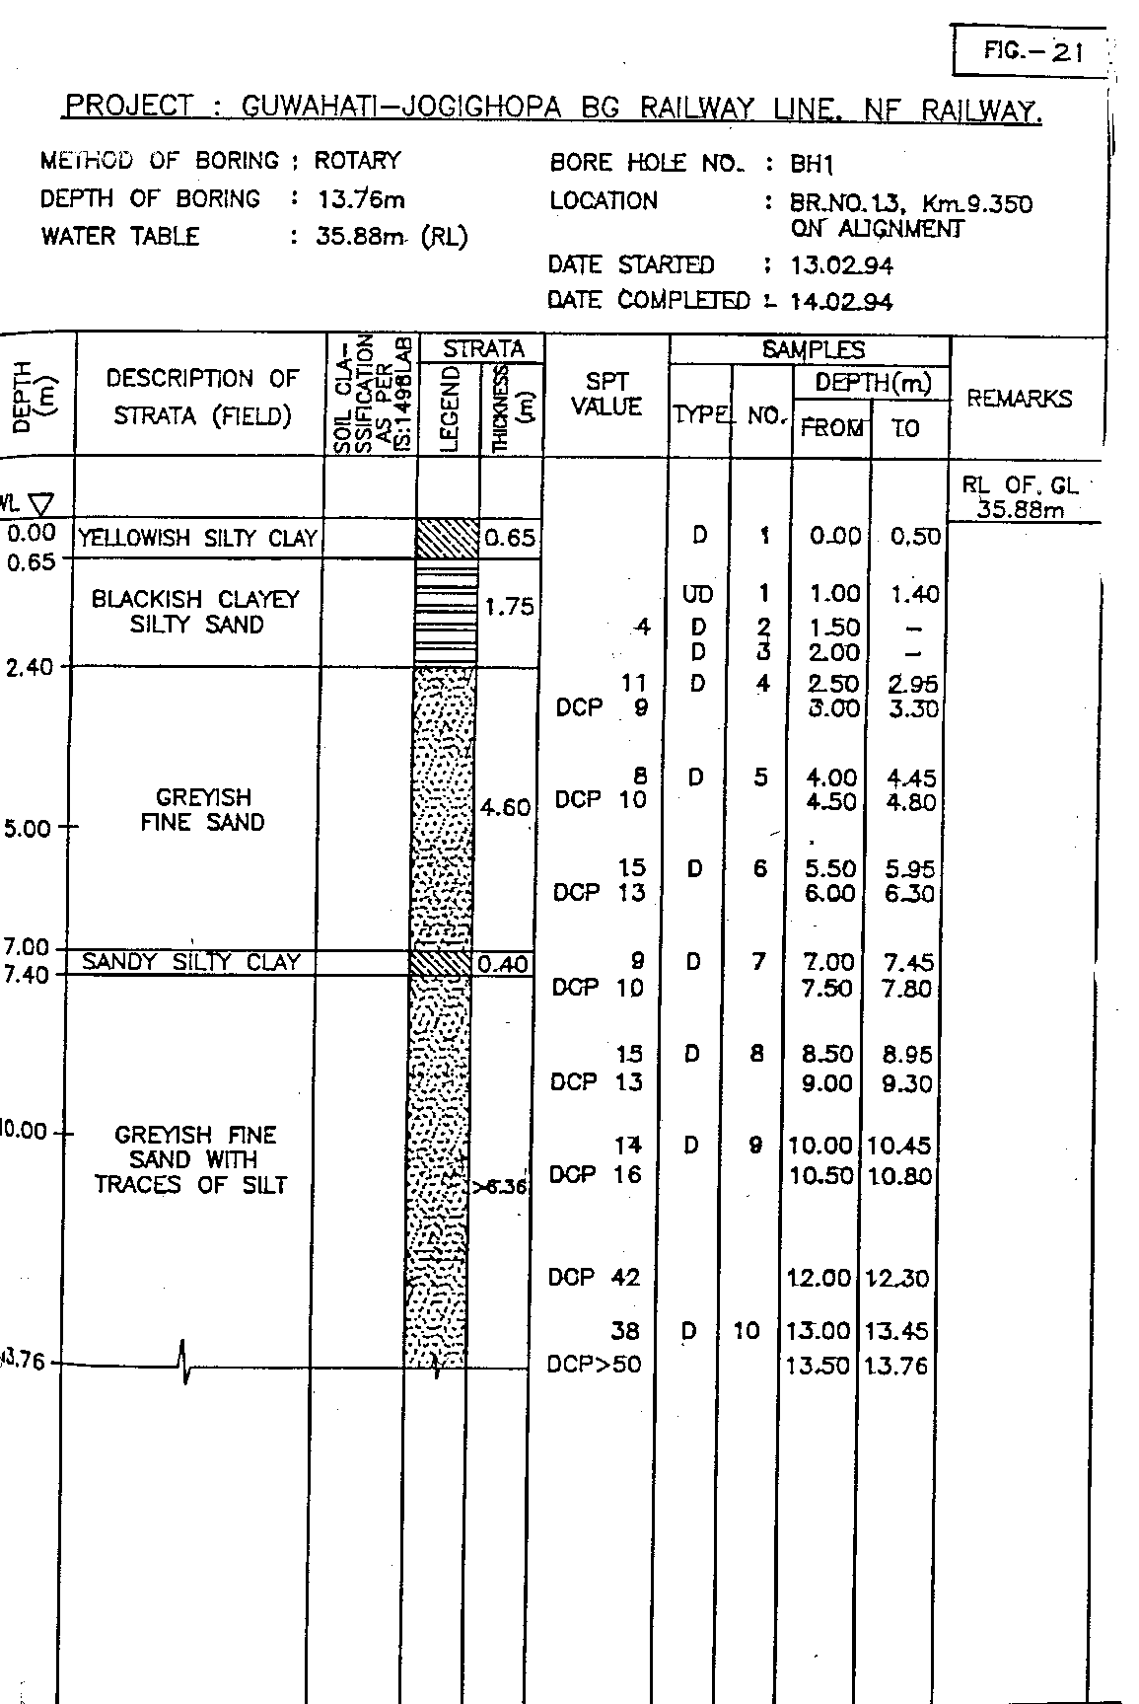
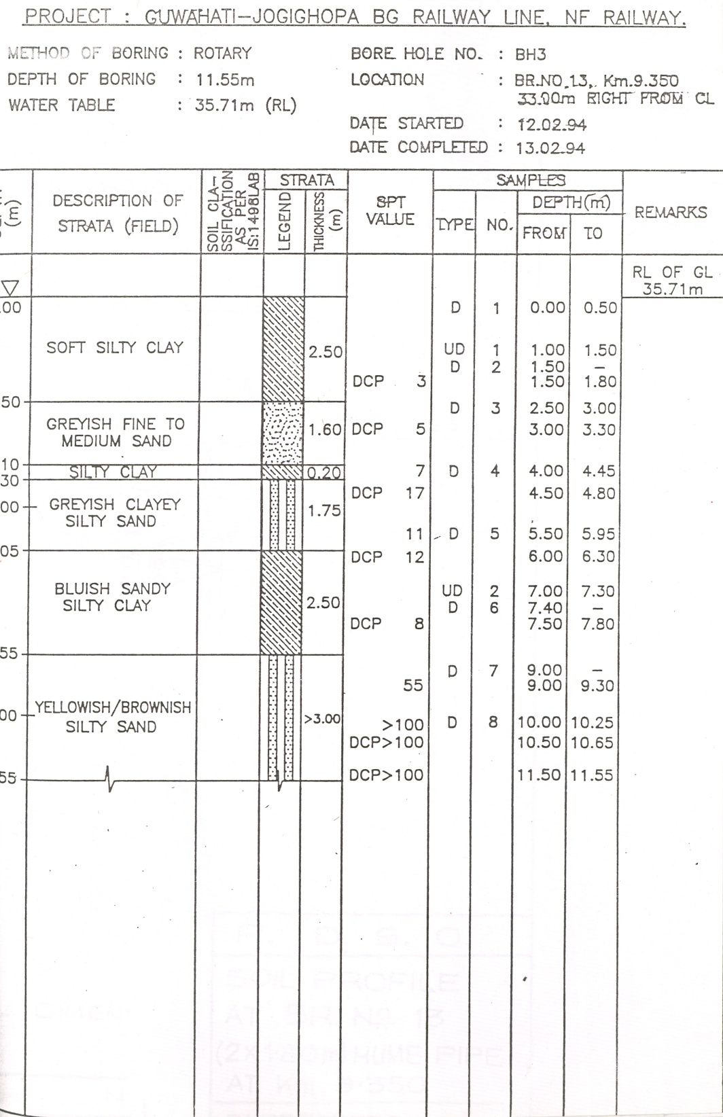

Slide 100
Laboratory Testing
Laboratory tests can be grouped broadly in two categories
Index property tests: These tests can be done on disturbed or on undisturbed samples
Mechanical property Tests: These tests are done on good quality undisturbed samples.

Slide 101
Common Laboratory Tests
Type of Test | Reference of IS CODE
Index Properties TEsts
1. Visual classification | IS: 1498
2. Sample preparation | IS: 2720 (Part I)
3. Natural water content | IS: 2720 (Part II)
4. Specific gravity | IS: 2720 (Part III)
5. Grain size analysis | IS: 2720 (Part IV)
6. Liquid & Plastic limits | IS: 2720 (Part V)
7. Shrinkage limit | IS: 2720 (Part VI)
8. Shrinkage characteristics | IS: 2720 (Part V=XX)
9. Relative density of cohesionless soils | ISL 2720 (Part XIV)

Slide 102
Common Laboratory Tests Contd…
Type of Test | Reference of Indian Standard Test Procedure
Mechanical Properties Tests
10. Shear strength test:
- Direct Shear | IS: 2720 (Part XIII)
- Unconfined compression | IS: 2720 (Part X)
- Triaxial compression | IS: 2720 (Part XI)
11. Consolidation | IS: 2720 (Part XV)
12. Permeability | IS: 2720 (Part XVII)
13. Compaction tests
- Light compaction | IS: 2720 (Part VII)
- Heavy compaction | ISL 2720 (Part VII)

Slide 103
Common Laboratory Tests Contd…
Type of Test | Reference of Indian Standard Test Procedure
Chemical Tests
14. Organic matter | IS: 2720 (Part XXII)
15. Base exchange capacity | IS: 2720 (Part XXIV)
16. Corrosivity tests:
- pH value | IS: 2720 (Part XXVI)
- Sulphate content | IS: 2720 (Part XXVII)

Slide 104
In-Situ Testing
A larger volume of soil is involved in in-situ testing compared to a small soil specimen used in laboratory testing.
Testing of large soil specimens in the lab presents practical problems besides being expensive.
Consequently in-situ testing is invariably included in important or major investigations as it has the advantage of including the influence of macro-fabric on measured soil properties.

Slide 105
In-Situ Testing Contd..
Macro-fabric means the defects in natural soil deposits, like inclusion, lenses, laminations, organic material, joints, fissures and bedding planes).
The small laboratory soil specimen can not include the frequently present macro-fabric and non-homogeneities of natural soil deposits
Lab test results in such soils therefore can’t truly represent field behavior of soil

Slide 106
In-Situ Testing Contd..
Another advantage of in-situ tests is that they can be carried out in soil deposits in which undisturbed sampling is still impossible or unreliable, as in cohesion less soils.
However there are several limitation associated with in situ testing, e.g., drainage conditions are generally unknown and it is not certain if the measured properties are for undrained, drained, or partially drained behaviour.
Lab testing offers the advantage of strictly controlled drainage conditions.

Slide 107
In-Situ Testing Contd..
Both methods of soil investigation – lab and in situ thus have inherent advantages and disadvantages.
Conventional geotechnical investigation programs include both in situ and lab test.
In general, in situ testing is more economical and less time consuming than testing of undisturbed specimens in laboratory.

Slide 108
In-Situ Testing Contd..
There are several in situ test commonly used.
Each can serve a very useful function provided its limitations are not exceeded.
It should however be noted that excepting the SPT, all other in-situ test have a range of design, manufacture, degree of sophistication etc.

Slide 109
Field Tests and Subsurface sounding
For measuring variation in the resistance of soil with depth. then these resistance used to co-relate with various type of soil properties.
Standard penetration test IS 2131-1968
Static cone penetration test IS 4968 part III 1976
Dynamic cone penetration test IS 4968 part I & II 1976
Plate Load test IS 1888 – 1982

Slide 110
Standard Penetration Test (SPT)
Split spoon sampler
Hammer – 65 Kg
Drop of hammer 750 mm
Driven 450 mm into the borehole in 3 stages
Blows for every 150 mm recorded
Readings for 1st 150 mm ignored – required for seating drive
Number of blows for last 300 mm reported as N value (adding the blows for each of last 2 - 150 mm penetrations

Slide 111
Standard Penetration Test (SPT)
Performed every 2-3 m depth as well as at change of strata
Test covered in IS 2131-1986 – Standard Penetration Test

Slide 112
SPT – Correction factors - 1
In the case of fine sand or silt below water-table, apparently high values may be noted for N (Terzaghi)
N = 15 + ½ x (N’ – 15)
N’ – Observed SPT value
N – Corrected SPT value

Slide 113
SPT – Correction factors - 2
For SPT made at shallow levels, the values are usually too low. At a greater depth, the same soil, at the same density index, would give higher penetration resistance
N = N’ x 350 /(σ +70)
N’ – Observed SPT value
N – Corrected SPT value
σ = effective overburden pressure in KN/m2, not exceeding 280 KN/m²

Slide 114
N Value Correlation for Sand
S. No. | Condition | N | D_{r} | φ
1 | Very Loose | 0 – 4 | 0 – 15% | Less than 28º
2 | Loose | 4 – 10 | 15 – 35% | 28° – 30°
3 | Medium | 10 – 30 | 35 – 65% | 30° – 36°
4 | Dense | 30 – 50 | 65 – 85% | 36° – 42°
5 | Very Dense | > 50 | > 85% | > 42°

Slide 115
N Value Correlation for Clay
S. No. | Condition | N | q_{u} (kN/m²)
1 | Very Soft | 0 – 2 | < 25
2 | Soft | 2 – 4 | 25 – 50
3 | Medium | 4 – 8 | 50 – 100
4 | Stiff | 8 – 15 | 100 – 200
5 | Very Stiff | 15 – 30 | 200 – 400
6 | Hard | > 30 | > 400
Correlation for clays is less reliable and therefore to find out the in-situ strength of clays Field Vane Shear is used

Slide 116
N values & Relative Density of sand
N-value | Relative Density
Below 4 | Very Loose
4-10 | Loose
10-30 | Medium
30-50 | Dense
Over 50 | Very Dense

Slide 117
VIDEO

Slide 118
N-values & Consistency of Cohesive Soils
N-value | Consistency
Below 2 | Very soft
2-4 | Soft
4-8 | Medium
8-15 | Stiff
15-30 | Very Stiff
Over 30 | Hard

Slide 119
Static Cone Penetration Test (SCPT)
IS: 4968 (Part-III)-1976—Method for subsurface sounding for soils—Part III Static cone penetration test
To find in-situ penetration resistance of soils
Determining bearing capacity of soil at various depths
Skin friction values for piles
Most successful in soft or loose soils like silty sands, loose sands, layered deposits of sands, silts and clays as well as in clayey deposits

Slide 120
Static Cone Penetration Test (SCPT)
Typical test for a depth of 15-20 m can be completed in a day – very fast method
Equipment consists of
steel cone
friction jacket
sounding rod
mantle tube
driving mechanism and measuring equipment

Slide 121
Static Cone Penetration Test (SCPT)
Steel cone shall be of steel with tip hardened
Apex angle of 60° ± 15′
Overall base diameter of 35.7 mm giving a cross-sectional area of 10 cm².
Friction jacket of high carbon steel
Sounding rod – steel rod of 15 mm diameter
Additional rods each of 1m length
For engine driven equipment – rate of travel 10 – 15 mm per second
Hydraulic pressure gauges or proving ring

Slide 122
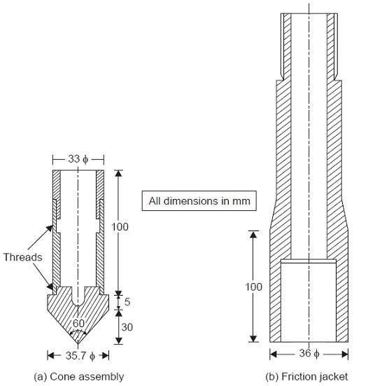
Cone Assembly and Friction Jacket for SCPT (IS)

Slide 123
Static Cone Penetration Test (SCPT)
Determining the frictional resistance
By pushing the cone
Then by pushing the cone and friction Jacket assembly
Results presented graphically
Graph 1 – Cone resistance in kN/m² with depth in meters
Graph 2 – Friction resistance in kN/m² with depth in meters
Cone resistance to be corrected for dead weight of the cone and the sounding rods
Correction for the ratio of the ram area to the base area of the cone
The test is unsuitable for gravelly soils and for soils with standard penetration value N greater than 50 and also the dense sand due to requirement of high anchorage forces

Slide 124
FOUR POSITIONS OF THE SOUNDING APPARATUS WITH FRICTION JACKET

Slide 125
SCPT – Correction for the mass of cone and sounding rods
1) Mass of cone, m = 1.1 kg*
2) Mass of each sounding rod, m₁ = 1.5 kg*
3) Cone area at base, b = 10 cm2
4) Plunger area( see Note )
5) Correction factor (to be added to gauge reading) =(m + nm₁)/10 kgf/m²
n = the number of rods in use
NOTE-If plunger area is 20 cm and base area of cone is 10 cm, the gauge readings should be multiplied by the ratio of the plunger area to the area of the base of the cone, that is 2.

Slide 126
Sample reading cone resistance including correction factor
Depth Below Ground Level (m) | Gauge Reading kN /m² ( kgf/cm² ) | Corrected Value of Cone Penetration Resistance kN/m² (kgf/cm²)
0.20 | 2150 (22.00) | 2176 (22.26)
0.40 | 900 (9.00) | 926 (9.26)
0.60 | 800 ( 8.00) | 826 (8.26)
0.80 | 1000 (10.00) | 1026 (10.26)
1.00 | 400 (4.00) | 426 (4.26)
1.20 | 500 (5.00) | 541 (5.41)
1.40 | 550 (5.50) | 591 (5.91)
1.60 | 800 (8.00) | 841 (8.41)
1.80 | 450 (4.50) | 491 (4.91)

Slide 127
SCPT – Correction for the mass of friction jacket
Mass of friction jacket = m_{f} kg (say 1.13 Kg)
Area of surface of friction jacket, a = π x dh cm² (3.14159*3.6*10.0) = 113.0972
Cone area at base, b = 10 cm²
Where
d = outer diameter of friction jacket (3.6 cm), and
h = length of friction jacket (10.0 cm)
4 ) Correction factor ( to be added ) = 100 m_{f} /a kN/m²
= m_{f} /a kgf/cm²

Slide 128
Sample reading friction resistance including correction factor
Depth Below Ground Level (m) | Total Resistance kN/m² (kgf/cm²) (x) | Cone Resistance (Uncorrected) kN/m² (kgf/cm²) (y) | Total Resistance Minus Cone Resistance kN/m² (kgf/cm²) (x-y) | Frictional Resistance kN/m² (kgf/cm²) z=(x-y)b/a | Corrected Frictional Resistance kN/m² (kgf/cm²) z + 100m_{f}/a (z + m_{f}/a)
2.10 | 1250 (12.5) | 900 (9.0) | 350 (3.5) | 30.9 (0.31) | 31.9 (0.32)
2.20 | 1300 (13.0) | 900 (9.0) | 400 (4.0) | 35.4 (0.35) | 36.4 (0.36)
2.30 | 1350 (13.5) | 1000 (10.0) | 350 (3.5) | 30.9 (0.31) | 31.9 (0.32)
2.40 | 1350 (13.5) | 1000 (10.0) | 350 (3.5) | 30.9 (0.31) | 31.9 (0.32)
2.50 | 1450 (14.5) | 1050 (10.5) | 400 (4.0) | 35.4 (0.35) | 36.4(0.36)
2.60 | 850 (8.5) | 550 (5.5) | 300 (3.0) | 26.5 (0.27) | 27.5 (0.28)
2.70 | 900 (9.0) | 450 (4.5) | 450 (4.5) | 39.8 (0.40) | 40.8 (0.41)
2.80 | 800 (8.0) | 400 (4.0) | 400 (4.0) | 35.4 (0.35) | 36.4 (0.36)
2.90 | 800 (8.0) | 450 (4.5) | 350 (3.5) | 30.9 (0.31) | 31.9 (0.32)

Slide 129
SCPT - Limitations
Not suitable for gravelly soils and soils having N value greater than 50
Unsuitable for filled up soil, which may contain solid objects like bricks, concrete pieces etc. may give erroneous values. So either remove the filled up soil or neglect the results in filled up soil
Anchorage arrangement in dense sand would be cumbersome and expensive

Slide 130
Dynamic Cone Penetration Test (DCPT)
To determine the resistance of different soil strata to dynamic penetration of a 50 mm cone
Thereby obtaining an indication regarding their relative strengths or density or both
Reconnaissance survey of wide areas in a shorter time
Provide useful data for local conditions where reliable correlations have been established with penetration tests by other methods

Slide 131
Dynamic Cone Penetration Test (DCPT)
Cone driven into the soil - hammer to fall freely through 750 mm
Number of blows for every 100 mm penetration recorded
Process repeated till the cone is driven to the required depth
To save equipment from damage, driving may be stopped when the number of blows exceeds 35 for 100 mm penetration
N_{cd} (Cone Penetration Value) value is number of blows for 300 mm penetration

Slide 132
Dynamic Cone Penetration Test (DCPT)
IS: 4968 (Part I) – 1976—Method for Subsurface Sounding for Soils—Part I Dynamic method using 50 mm cone without bentonite slurry
Cone with threads (recoverable) – steel with tip hardened
Cone without threads (expendable) may be of mild steel
Cone without threads uses a cone adopter

Slide 133
Cone details for DCPT (IS code)

Slide 134
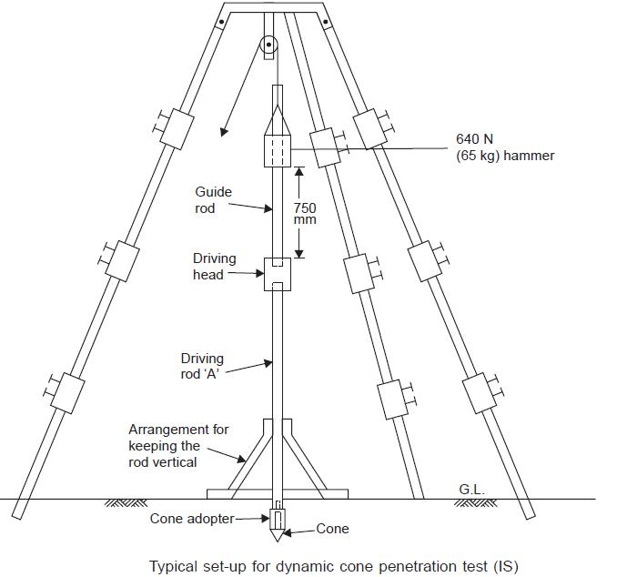

Slide 135
Dynamic Cone Penetration Test (DCPT)
The driving rods should be A rods of suitable length with threads for joining A rod coupling at either end (OD – 41.27 and ID – 28.57 mm)
The rods should be marked at every 100 mm.
Driving head – Mild steel with threads at either end for a rod coupling
Diameter of 100 mm
Length of 100 to 150 mm.
Suitable hoisting equipment such as a tripod
Hammer – Mild Steel or Cast Iron – 250 mm high and suitable diameter having 65 Kg weight

Slide 136
Dynamic Cone Penetration Test (DCPT)
Cone driven into the soil by allowing the hammer to fall freely through 750 mm each time
Number of blows for every 100 mm penetration of the cone shall be recorded
Process repeated till the cone is driven to the required depth
To avoid equipment damage – driving stopped when No. of blows >35 for 100 mm penetration

Slide 137
Dynamic Cone Penetration Test (DCPT)
Depth of investigation if more than 6 m, bentonite slurry may be used for eliminating the friction on the driving rods
Cone used in this case is of 62.5 mm
IS: 4968 (Part-II)-1976—Method for subsurface Sounding for Soils—Part II, Dynamic method using 62.5 mm cone and bentonite slurry

Slide 138
Dynamic Cone Penetration Test (DCPT)
ADVANTAGES OF DCPT
Simple Device
Advantage over SPT in the sense that making of borehole is avoided
Provides continuous record of soil resistance

Slide 139
In-situ Vane Shear Test
IS: 4434-1978—Code of Practice for In-situ Vane Shear Test for Soils
Determination of shear strength of saturated cohesive soils, especially of sensitive clays, susceptible for sampling disturbances
Consists of pushing a four-bladed vane in the soil and rotating it till a cylindrical surface in the soil fails by shear
The torque required to cause this failure is measured and this torque is converted to a unit shearing resistance of the cylindrical surface
Test may be conducted from the bottom of a bore hole or by direct penetration from ground surface.

Slide 140
In-situ Vane Shear Test
Two methods of the test, namely,
testing from bottom of a bore-hole and
by direct penetration from ground surface, are covered. Determination of shear strength of saturated cohesive soils, especially of sensitive clays, susceptible for sampling disturbances
Vane shall consist of four mutually perpendicular blades as illustrated
Height of the vane shall be twice the overall diameter
overall diameter of the vane should be 37.5 ,50 ,65 ,75 or 100 mm
Design should be such (with minimum thickness of blades) so as cause least disturbance to soil while inserting

Slide 141
In-situ Vane Shear Test
The vane blades shall be welded together suitably either directly or to a central rod, the maximum diameter of which should preferably not exceed 12.5 mm.
The area ratio of the vane shall be kept as low as possible
Shall not exceed 18% for the 37.5 mm vane
And 12% for the 50, 65, 75 and 100 mm vanes

Slide 142
In-situ Vane Shear Test
The area ratio may be calculated using the following formula:
where
A_{r} = area ratio in percent,
t = thickness of vane blades in mm
D = overall diameter of vane in mm, and
d = diameter of central vane rod including any enlargement due to welding in mm.

Slide 143
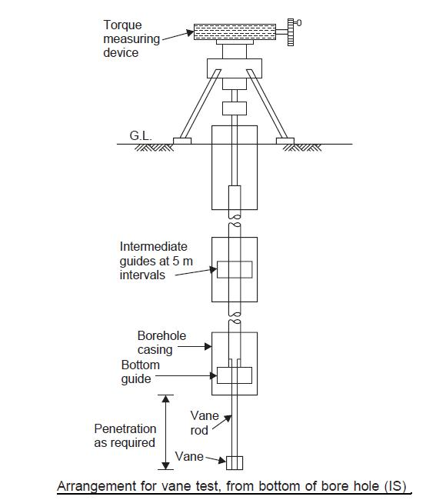
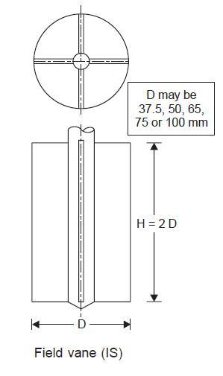
Equipment -
Shear vane
Torque applicator
Rods with guides
Drilling equipment
Jacking arrangement
May be in suitably designed sleeve

Slide 144
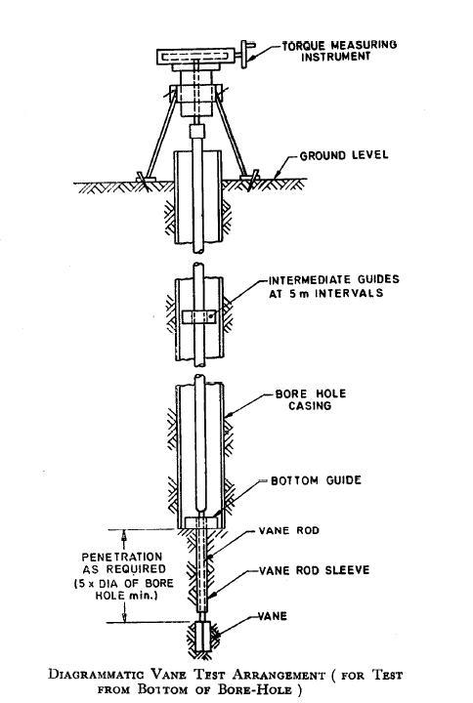
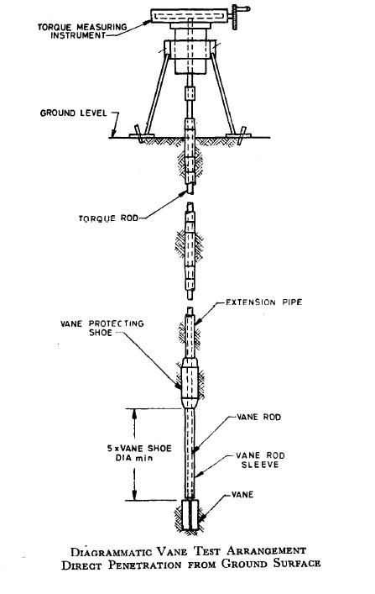

Slide 145
In-situ Vane Shear Test
Instrument shall be capable of applying a torque to the vane through the string of rods and to measure the same
It should also have a device to read the angular rotation of the upper end of the extension rod
The torque applicator shall be provided with speed control so that the rate of rotation may be maintained at 0.1º/s
Friction exerted by the torque applicator should be of negligible magnitude and shall be checked periodically
Depending upon the estimated shear strength of the soil, the following table should be used to select the torque applicator
The torque rods (which are preferably 1 m long or smaller) shall be guided (spacing not > 5 m) so as to prevent friction from developing between the torque rods and the walls of casing or boring.

Slide 146
TABLE 1 SELECTION OF TORQUE APPLICATOR
Estimated shear strength in kN/m² (kgf/cm²) | 10 (0.1) | 20 (0.2) | 30 (0.3) | 40 (0.4) | 50 (0.5) | 60 (0.6) | 70 (0.7)
Vane size diameter suitable for use with 600 kgf.cm torque applicator | All sizes | All sizes except 100 mm | All sizes except 100 mm | All sizes except 100 and 75 mm | All sizes except 100 and 75 mm | All sizes except 37.5 and 50 mm | All sizes except 37.5 and 50 mm
The capacity and accuracy of the instrument shall be one of the following as may be specified by the purchaser:
a) Measure torque up to 60 Nm (600 kgf cm) to an accuracy of 1 Nm (10 kgf cm), or
b) Measure torque up to 200 Nm (2000 kgf cm ) to an accuracy of 2.5 Nm (25 kgf.cm)

Slide 147
In-situ VST – Test from bottom of bore hole
Drill the bore hole to desired depth – Sink and secure the casing
Connect vane of suitable size to the rods and lower in the casing providing guides at intervals of not more than 5 m
Push the vane with a moderate steady force up to a depth of five times the diameter of the bore-hole below the bottom of the bore-hole or shoe
Allow 5 minutes and then apply the torque to rotate vane @ not more than 0.1º/second
Rotate continuously and take readings at ½ minute intervals
Take the reading of the maximum torque and after it drops, rotate rapidly for 10 revolutions and take remoulded strength readings after 1 minute

Slide 148
In-situ VST – Test by direct penetration from ground surface
Instrument shall be capable of applying a torque to the vane through the string of rods and to measure the same
It should also have a device to read the angular rotation of the upper end of the extension rod
The torque applicator shall be provided with speed control so that the rate of rotation may be maintained at 0.1º/s
Friction exerted by the torque applicator should be of negligible magnitude and shall be checked periodically
Depending upon the estimated shear strength of the soil, the following table should be used to select the torque applicator
The torque rods (which are preferably 1 m long or smaller) shall be guided (spacing not > 5 m) so as to prevent friction from developing between the torque rods and the walls of casing or boring.

Slide 149
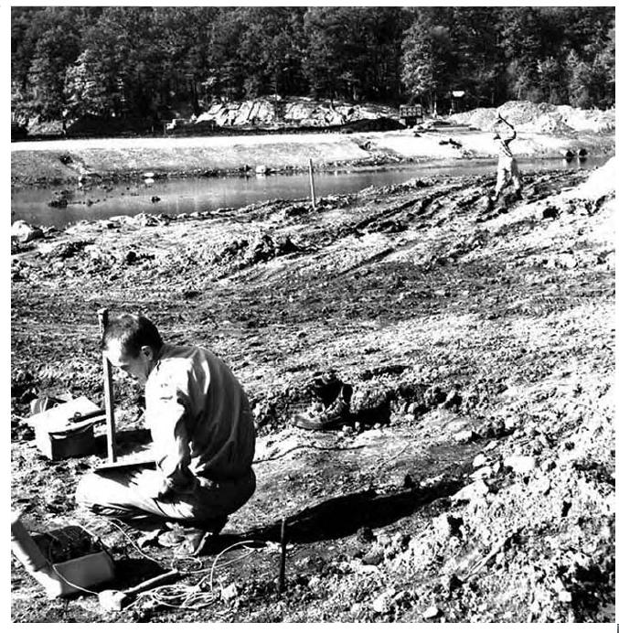
Seismic Method - Refraction
Source of Energy – Hammer Strike
Recording of Waves - Geophone

Slide 150
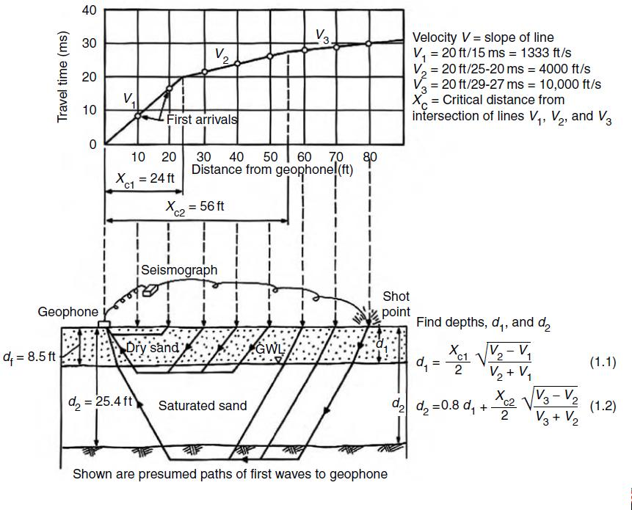
Seismic Method - Refraction

Slide 151
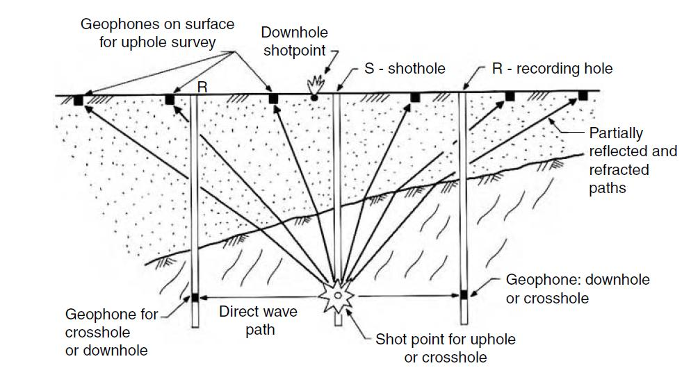
Seismic Method – Direct
(Up Hole, Down Hole and Cross Hole)

Slide 152
PLATE LOAD TEST

Slide 153
PLATE LOAD TEST
AS PER IS:1888-1982
FOR DETERMINATION OF IN SITU ULTIMATE SOIL BEARING CAPACITY
MAIN ASSUMPTION IS THAT
‘THE SOIL STRATA IS REASONABLY UNIFORM’

Slide 154
APPARATUS FOR PLT
Loading plate - Circular or square bearing plates of mild steel not less than 25 mm in thickness
Truss of sufficient size for loading
Loading set-up may be any type
Gravity loading
Reaction loading
Hydraulic jack of required capacity with properly calibrated measuring device for load measurement

Slide 155
APPARATUS FOR PLT contd..
Chequered or grooved bottom of plate, with handles for convenient setting. It should be centre marked.
Settlement recording device (dial gauges with 25-50 mm travel & capable of measuring settlement to an accuracy of 0.01 mm)
Datum beam or rod of sufficient strength

Slide 156
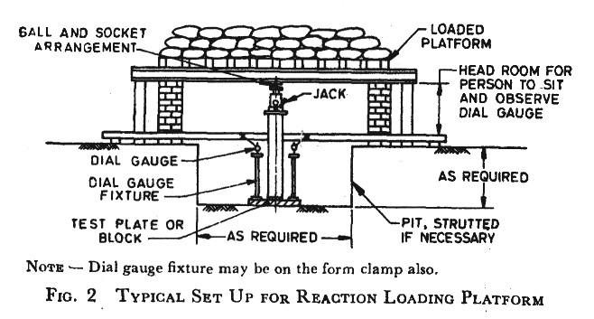

Slide 157
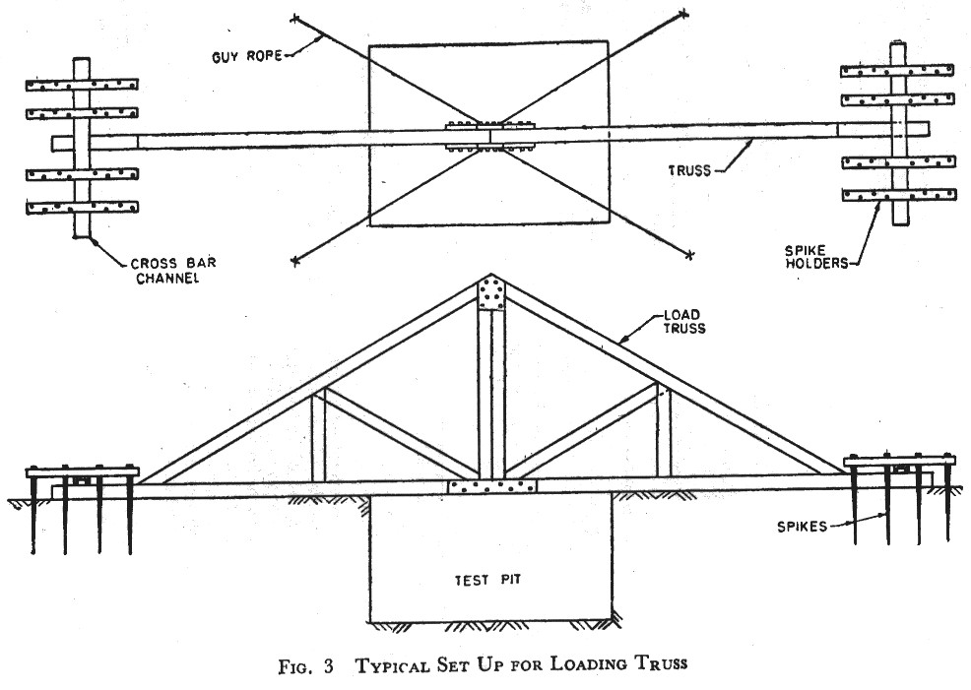

Slide 158
PROCEDURE OF PLT
The test shall be conducted at a depth of proposed foundation level
If water table is within the depth equal to width of test plate, conduct the test at water table level.
In case water table is higher than the test level, lower it to the test level. However for sandy soils the test can be conducted at water table level.
Width of test pit 5 times the width of test plate

Slide 159
PROCEDURE OF PLT contd..
Should have carefully levelled and cleaned bottom
Except in case of load problems /circular footings, square plate may be used. ………
For clayey and silty soils /loose to medium dense sandy soils with N<15 a 450 mm square plate
For dense sandy/gravely soils(15<N<30) three plates of sizes 300mm to 750 mm.
The side of the plate should be minimum 4 times the max. size of the soil particle present at the test location.

Slide 160
TEST ARRANGE. & READINGS
The loading platform should be supported by suitable means at least 2.5 m from the test area. No support should be within 3.5 times size of test plate from its centre.
Plate shall be placed over a fine layer (thickness not exceeding 5 mm) of sand
The test plate should be perfectly levelled
The jack should be placed centrally over the plate

Slide 161
TEST ARRANGE. & READINGS contd..
A minimum seating pressure of 70 g/cm² shall be applied and removed before starting the load test.
Dial gauges for measuring settlement should be placed diagonally opposite.
Apply the load in equal increments of 1 kg/cm² or one fifth of the estimated ultimate bearing capacity (whichever is less).
Settlement should be observed for each increment of load after an interval of 1, 2.25, 4, 6.25, 9, 16 and 25 minutes. And thereafter at hourly intervals to the nearest 0.02 mm.

Slide 162
TEST ARRANGE. & READINGS contd..
For clayey soils , the time settlement curve is plotted at each load stage and the load shall be increased to the next stage either when the curve indicates that 70 to 80 % of the probable ultimate settlement has taken place at that stage or at the end of 24 hours period.
For soils other than clayey soils, each load increment shall be kept for a period of minimum 1 hour or up to a time when the rate of settlement gets appreciably reduced to a value of 0.02mm/min.

Slide 163
TEST ARRANGE. & READINGS contd..
The test shall be continued till the settlement of 25 mm in normal cases or 50 mm in special cases (such as dense gravel, gravel and sand mixture) is obtained or till failure occurs.
Alternatively, where settlement < 25 mm , the test should continue up to at least twice the estimated design pressure.
If needed the rebound observations may also be taken.

Slide 164
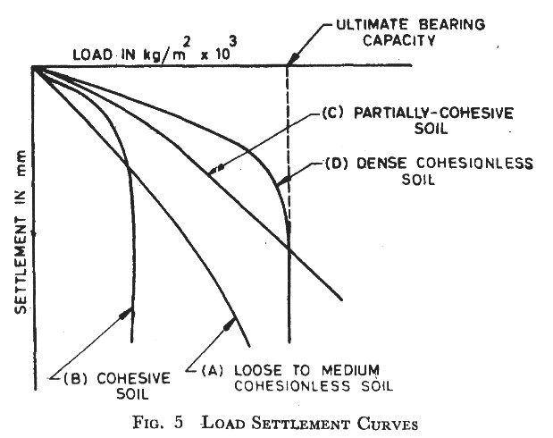

Slide 166
Permissible Settlement
Permissible settlement of footing (S_{f})
S_{f} = S_{p} {B_{f} (B_{p}+0.3)}² / {B_{p}(B_{f} +0.3)}²
Where B_{f} = the size of footing in mm.
B_{p} = size of test plate in mm.
S_{p} = settlement of test plate in mm.

Slide 167
LIMITATIONS OF PLT
Test results reflect only the character of the soil located within a depth of less than twice the width of the bearing plate
Does not give the ultimate settlement particularly in case of cohesive soils
If the character of the soil changes at shallow depth , the results are not reliable
If a weaker stratum exists below the level of footing , adequate soil exploration is required to be done.

Slide 168
LIMITATIONS OF PLT contd
The test with smaller size plates give conservative values in dense sandy soils. Though for cohesive soils the bearing capacity is independent of size of bearing plate .
Therefore in sandy soils , the test should be conducted with three different sizes of plates and the results should be extrapolated for the actual size of foundation.

Slide 169
Common In-Situ Tests
Test type and suitability | Measured Properties | Limitations
1. Standard penetration Test (SPT) | Blow count N, measured by counting the number of blows required to drive the Standard Spoon by 30 Cm into the ground by a 63.5 kg hammer falling from 75cm. Disturbed soil sample also obtained. | Very rough correlation with un drained shear strength (Cu) of cohesive soils. Boulders can cause problem. Results are sensitive to test details.
IS: 2131 Best for Granular soils particularly sand

Slide 170
Common In-Situ Tests (contd)
Test type and suitability | Measured Properties | Limitations
2. Dynamic Cone Penetration Test (DCPT) | Same as SPT except that in this, a Standard Cone is driven with a 65kg hammer and no sample is obtained. | Gravels and boulders may give misleading results. Local correlation with SPT value required.
IS: 4968 Pt I & II Best for Sand and Gravel

Slide 171
Common In-Situ Tests (contd)
Test type and suitability | Measured Properties | Limitations
3. Static Cone Penetration Test (CPT) | Point resistance & Sleeve friction is measured electrically or mechanically, by pushing a Standard Cone at the rate of 1-2m/minute | Dense and hard soils need high capacity equipment to push. Cobbles and boulders cause problem. Local correlation required for soft clay.
IS: 4968 Pt III Best for All soils except very coarse granular soils

Slide 172
Common In-Situ Tests (contd)
Test type and suitability | Measured Properties | Limitations
4. In Situ Vane Shear Test (VST) | Undrained shear strength (Cu) measured by inserting a metallic vane into the soil and rotating it to shear the soil cylindrically. | Unreliable if the vane encounters sand layers, stones, etc., or if vane is rotated too rapidly.
IS: 4434 Best for soft to stiff clays

Slide 173
Common In-Situ Tests (contd)
Test type and suitability | Measured Properties | Limitations
5. Plate Load Test (PLT) | Allowable bearing pressure, modulus and settlement of shallow foundations measured by loading a small test plate and measuring the corresponding settlement. | Strictly applicable if the deposit is uniform. Most useful for granular soils. Gives only short term settlement in clays. Depth of influence limited to approximately twice the plate width.
IS: 1888 Best for Sand and clay

Slide 174
THANKS

Slide 175
References
WWW.geotechlinks.com
Hand Book on Soil Engineering by RDSO
IS:1892-1979 Subsurface Investigation Foundation
Para 409,424,425 & 527 of Engineering Code
Is:2131-1981 Code of Practice on Standard Penetration Test

Slide 176
References (Contd)
IS:1888-1982 Plate Load Test
IS:6926-1973 Code of Practice for Diamond Core Drilling
IS:5313-1980 Code of Practice for Core Drilling Operation
IS:6403-1981 BC & N Values Relation
IS:9640-1980 Split Spoon Sampler

Slide 177
References (Contd)
IS:2720 Method of Test for Solis
IS:1498 Classification & Identification of Soils
IS:4464 Presentation of Drilling Information and Core Description in Foundation Investigation
IS:8763 guide for undisturbed sampling of sands
IRC:78 Standard Specification & Code of Practice for Road Bridges

Slide 178
Common Laboratory Tests
Type of Test | Reference of IS CODE
Index Properties Tests
1. Visual classification | IS: 1498
2. Sample preparation | IS: 2720 (Part I)
3. Natural water content | IS: 2720 (Part II)
4. Specific gravity | IS: 2720 (Part III)
5. Grain size analysis | IS: 2720 (Part IV)
6. Liquid & Plastic limits | IS: 2720 (Part V)
7. Shrinkage limit | IS: 2720 (Part VI)
8. Shrinkage characteristics | IS: 2720 (Part V=XX)
9. Relative density of cohesionless soils | ISL 2720 (Part XIV)

Slide 179
Common Laboratory Tests (Contd…)
Type of Test | Reference of Indian Standard Test Procedure
Mechanical Properties Tests
10. Shear strength test:
- Direct Shear | IS: 2720 (Part XIII)
- Unconfined compression | IS: 2720 (Part X)
- Triaxial compression | IS: 2720 (Part XI)
11. Consolidation | IS: 2720 (Part XV)
12. Permeability | IS: 2720 (Part XVII)
13. Compaction tests
- Light compaction | IS: 2720 (Part VII)
- Heavy compaction | ISL 2720 (Part VII)

Slide 180
Common Laboratory Tests (Contd…)
Type of Test | Reference of Indian Standard Test Procedure
Chemical Tests
14. Organic matter | IS: 2720 (Part XXII)
15. Base exchange capacity | IS: 2720 (Part XXIV)
16. Corrosivity tests:
- pH value | IS: 2720 (Part XXVI)
- Sulphate content | IS: 2720 (Part XXVII)

Slide 181
Correlation of N_{cbr} values with N values
For the 62.5 mm cone driven dry up to a depth of 9 m ( without bentonite slurry ) [ see IS : 4968 ( Part II )-19’76t 1, for medium to fine sands, the following relationships have been developed by the Central Building Research Institute, Roorkee. These relationships, when utilized, shall be used with caution.
N_{cbr}- 1.5 N up to a depth of 4m
N_{cbr} – 1.75 N for depths of 4 to 9 m.
where
N_{cbr} - cone resistance obtained with a 62.5 mm cone driven dry ( number of blows for 300 mm -penetration ); and
N - resistance to penetration in standard penetration test ( in accordance with IS :2131-1963*), (number of blows for 300 mm penetration)
DCPT using 50 mm cone as N_{cd} and that to a 62.5 mm cone using bentonite slurry as N_{cbr} [ IS : 4968 ( Part II )-1976

